Slide 1

The Linux Environment Chapter # 4 Lecture # 13, Week # 7
Dr. Muhammad Bilal Qureshi
m.qureshi@centralasian.uz
Central Asian University, Tashkent, Uzbekistan

Slide 2
Source
Textbook:
Beginning Linux Programming 4th Edition by Neil Matthew
Chapter # 4

Slide 3
Contents of Chapter
Passing arguments to programs (getopt,getopt_long)
Environment variables
Date & Time
Temporary files
Getting information about the user, the host and logging system information

Slide 4
Program Arguments
When Linux program runs using C language , it starts at the function main. For these programs, main is declared as :
int main (int argc, char *argv[])
Where argc is a count of the program arguments and argv is an array of character strings representing the arguments themselves.
You might also see C programs for Linux simply declaring main as main ()
This will still work, because the return type will default to int and formal parameters that are not used in a function need not be declared. argc and argv are still there, but if you don’t declare them, you can’t use them.

Slide 5
Program Arguments (Cont..)
Whenever the OS starts a new program, the parameters argc and argv are setup and passed to main. These parameters are usually supplied by another program, very often the shell that has requested that the OS start the new program.
Linux shell normally performs wild card expansion of filename arguments before argc and argv are set, whereas MS-DOS shell expects program to accept argument with wild card and perform their own wild card expansion.
argc: 4
argv = {“myprog”, “left”, “right”, “and center”}
The program myprog will start at main with parameters:
For example, if we give the shell the following command $ myprog left right ‘and center’
Notes:
Linux Shell (e.g., Bash):
In Linux, the shell (e.g., Bash) performs wild card expansion (globbing) before passing the arguments to the program.
For example, if you run ./program *.txt, the shell expands *.txt to a list of matching filenames before invoking the program ./program with those filenames as arguments.
MS-DOS Shell:
In MS-DOS (and similarly in Windows Command Prompt), the shell expects programs to accept arguments with wild cards and perform their own wild card expansion.
For example, if you run program *.txt in MS-DOS, the shell passes *.txt as it is to the program, and the program needs to handle the wild card expansion itself.

Slide 6
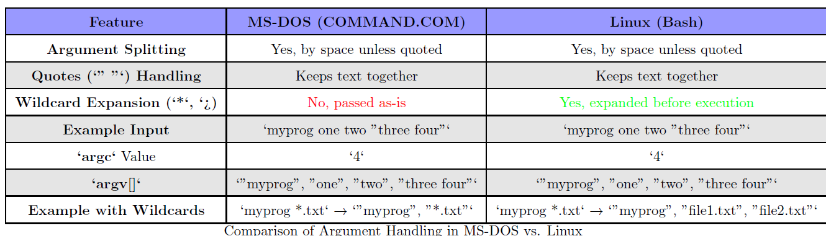
MS DOS Prompt vs Linux Shell (Bash)

Slide 7
Program Arguments (Cont..)
Note that the argument count includes the name of the program itself and argv array contains, the program name as its first element, argv[0],
The arguments of main corresponds to positional parameters in shell scripts, $0,$1 and so on.
Command-line arguments are useful for passing information to programs.
DB applications to pass the name of the DB you want to use, which would allow you to use the same program on more than one DB.
Many utility programs also use command-line argument to change their behavior set options. You would usually set these so-called flags or switches, using command-line arguments that begin with a dash. e.g., the sort program takes a switch to reverse the normal sort order.
$ sort –r file
Notes:
Command-line options are very common and using them consistently will be a real help to those who use your program. In the past each utility program adopted its own approach to command-line options which led to some confusion.

Slide 8

Program Arguments (Cont..)
For example, look at the way these commands take parameters:
$ tar cvfB /tmp/file.tar 1024
$ dd if=/dev/fd0 of=/tmp/file.dd bs=18k
$ ps ax
$ gcc --help
$ ls -lstr
$ ls -l -s -t –r
Notes:
cvfB: These are options used with the tar command:
c: Create a new archive.
v: Verbose mode. Print the names of the files being archived.
f: Specifies the filename of the archive to create.
B: This option is used for creating very large tar archives, and it splits the archive into
dd: A low-level copying command in Linux. if=/dev/fd0: Specifies the input file (in this case, the floppy disk device /dev/fd0). of=/tmp/file.dd: Specifies the output file (/tmp/file.dd), which will be a raw copy of the floppy disk. bs=18k: Sets the block size to 18 KB for efficient copying. -l → Long format listing (shows file permissions, owner, size, and timestamp). -s → Displays the file size in blocks. -t → Sorts files by modification time (newest first). -r → Reverses the sorting order (oldest first instead of newest first)

Slide 9

Program Argument (Cont..)
In Linux it is recommend that in your applications all command-line switches start with a dash and consist of a single letter or number. If required, options that take on no further arguments can be group together. So, the two ls examples shown above do follow guidelines.
Each option should be followed by any value it required as a separate argument. The dd example breaks our rule by using multi-character option and don’t start with dashes (if=/dev/fd0); and the tar example separates options and their values completely!
It is advisable to add longer, more meaningful switches names as alternatives to single character version and to use double dash dash to distinguish them. So, we might have –h and --help as options to help.

Slide 10
Program Arguments (Cont..)
Another little foible of some programs is to make the option +x (for example) perform the opposite function to –x. we used set –o xtrace to set shell execution tracking on, and set +o xtrace to turn it off gain.
Remembering the order and meaning of all these program options is difficult enough without having to cope with particular formats. Often, the only recourse is to use an –h (help) option or man page if the programmer has provided one.
Similarly, getopt provides a neat solution to these problems. For the moment, though, let’s just look at dealing with program arguments as they are passed.
Notes:
man bash
Then search for "xtrace" inside the manual by pressing /xtrace and hitting Enter.
Help set

Slide 11
getopt library function summary
Simplifies Argument Parsing – Instead of manually iterating through argv, getopt makes it easier to handle options with or without values.
Supports Short and Long Options – It can process short options (-a, -b) and long options (--help, --version).
Detects Missing or Invalid Arguments – If an expected value is missing or an unknown option is provided, getopt can handle errors appropriately.
Standardized Approach – It follows a common pattern used in Unix/Linux programs, making code more maintainable and familiar to other developers.
Reduces Boilerplate Code – Instead of writing complex loops and conditionals, getopt provides a clean and efficient way to process command-line input.

Slide 12
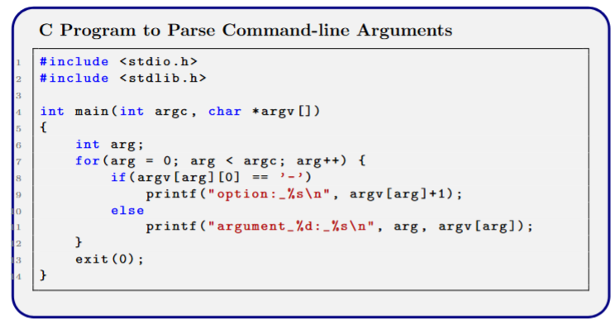
Example…
Here’s a program, args.c, that examines its own arguments:
When you run the program, it just prints out its arguments and detects the options. The intention is that the program takes a string argument and an optional filename introduced by an –f option. Other options might also be defined.
$ ./args -i -lr ‘hi there’ -f fred.c
argument 0: ./args
option: i
option: lr
argument 3: hi there
option: f
argument 5: fred.c
Notes:
How It Works The program simply uses the argument count, argc, to set up a loop to examine all of the program arguments.
It detects options by looking for an initial dash. In this example, if we intended the options -l and -r to be available, we’ve missed the fact that the -lr perhaps ought to be treated the same as -l -r

Slide 13
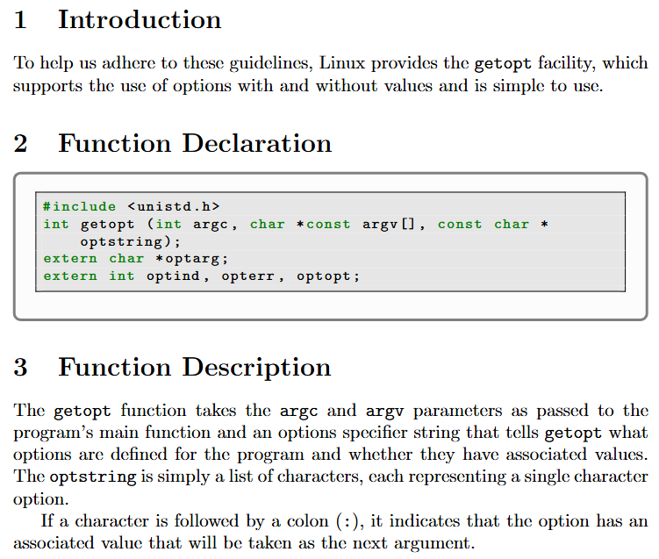
getopt library function
Notes:
In first case pointer is constant whereas in second case pointer is not constant but the string is.
By using getopt, your program can provide a user-friendly and standardized way to accept command-line options and arguments, enhancing its usability and flexibility.

Slide 14
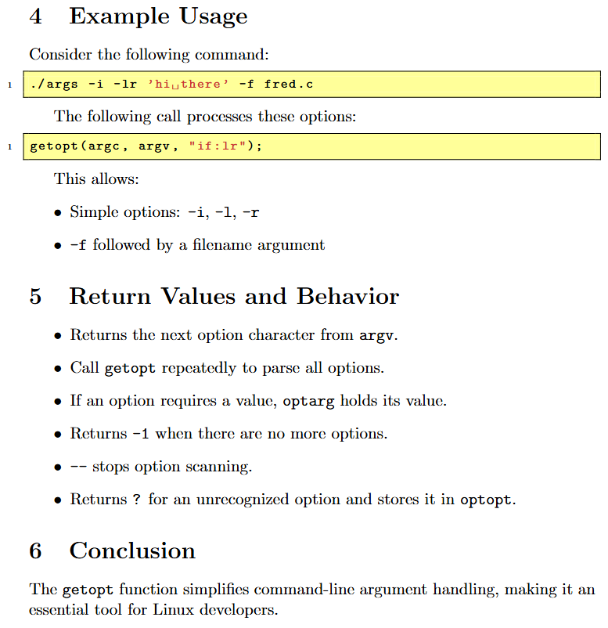
getopt cont()

Slide 15
getopt Cont()..
If an option requires a values (such as –f in our example) and no value is given, getopt normally returns ?, By placing a colon as the first character of the options string, getopt returns : instead of ? when no value is given.
The external variable, optind, is set to the index of the next argument to process, getopt uses it to remember how far it’s got. Programs would rarely need to set this variable. When all the option arguments have been processed, optind indicates where the remaining arguments can be found at the end of the argv array.

Slide 16
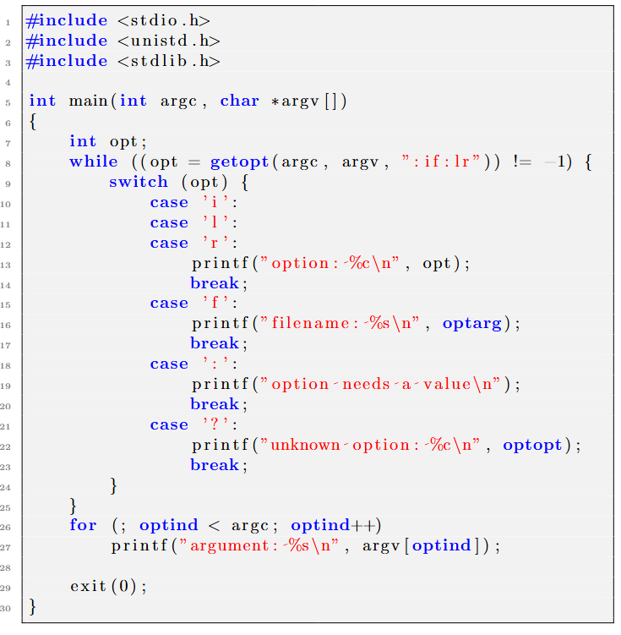
Example..
Now when you run the program, you see that all the command-line arguments are handled automatically:
$ ./argopt -i -lr ‘hi there’ -f fred.c -q
option: i
option: l
option: r
filename: fred.c
unknown option: q
argument: hi there
Notes:
How It Works The program repeatedly calls getopt to process option arguments until none remain, at which point getopt returns -1. The appropriate action is taken for each option, including dealing with unknown options and missing values. Depending on your version of getopt, you might see slightly different output from that shown here — especially error messages — but the meaning will be clear.
Once all options have been processed, the program simply prints out the remaining arguments as before, but starting from optind.

Slide 17
More Examples
Examples

Slide 18
Thank You
Questions?

